Slide 1

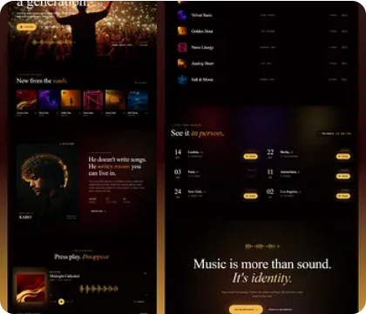
ACADEMIC PROJECT REVIEW
HTML5 • CSS3 • JS
Music Streaming Platform
A lightweight web application delivering browser-based audio playback, local storage authentication, and dual-module administration.
HTML5 & CSS Grid
JavaScript
LocalStorage Auth
System Requirements & Architecture Review
GitHub Repository Ready

Slide 2




PROJECT FOUNDATION
Problem Statement & Core Objectives
Pure Web Stack
The Problem Statement
Zero framework dependencies using native HTML5, CSS3, and JS.
Melodify allows users to explore trending songs, discover different music genres, search for songs, play music, like their favorite tracks, and manage playlists. The platform also includes a dedicated Admin Dashboard for managing songs and registered users.:
LocalStorage Authentication
Persistent signup, login, and session persistence in browser storage.
Framework Overhead: Heavy library dependencies for simple state routing.
Fragmented Access: Lack of unified role management across web interfaces.
Dynamic Navigation
Seamless module-wise view switching without browser page reloads.

Slide 3
SYSTEM ARCHITECTURE
Core Business Systems & Modules
MODULE 01
MODULE 02
Admin Module
User Module
Central control dashboard for platform content and user management.
Interactive listener portal for music discovery and custom playlists.
Track Management
Audio Playback Engine
Add, update, and delete songs in global library.
Play, pause, seek, volume control, and auto-advance.
Genre Categorization
Dynamic Search & Filter
Organize audio catalog by genre, artist, and album.
Real-time search across tracks, artists, and playlists.
Platform Overview
Personal Library
Monitor registered user metrics and library size.
Save favorite songs and construct personal playlists.

Slide 4



UI & FRONTEND IMPLEMENTATION
Layout Template & Dynamic Navigation
CSS Grid & Flexbox
JS Route Navigation
Audio Controls Panel
Responsive dashboard layout structured entirely with modern layout primitives.
Client-side module switching using JavaScript DOM manipulation.
Fixed-bottom player interface synchronized with active audio stream.
• Flexbox for Sidebar & Player Bar
• CSS Grid for Music Card Galleries
• Zero Full Page Reloads
• Dynamic View Controller Logic
• HTML API Binding
• Drag Progress & Volume Sliders
Technical Constraint Check:
100% Pure HTML, CSS, & JS — 0 External Libraries / Frameworks
PASSED

Slide 5
DATA PERSISTENCE & AUTHENTICATION
LocalStorage Authentication Pipeline
STEP 01
STEP 02
STEP 03
STEP 04
User Signup
JSON Serialization
Login Verification
Role Navigation
Validates inputs and pushes new user profile objects.
Converts JS objects into string format for browser storage.
Break down stored users and authenticates input credentials.
Sets active session flag and routes to Admin or User view.
usersDB.push(newUser)
localStorage.setItem()
JSON.parse(localStorage)
navigateByRole(user)
Persistent User Session State
Session state, custom created playlists, and favorited songs persist across browser refreshes and system reloads.

Slide 6
Requirement Verification Matrix
# | Project Requirement | Implementation Strategy | Status
01 | Problem Statement | Clear definition of web-based streaming without downloads.
02 | Dual Business Modules | Functional Admin Module & User Streaming Module.
03 | Tech Stack Constraint | Pure HTML, CSS, and JS. Zero external frameworks.
04 | Layout Template | Implemented UI structure using CSS Grid and Flexbox.
05 | Signup & Login Flow | Browser Local Storage serialization & credential checks.
06 | Module Navigation & GitHub | Dynamic JS routing and full source code pushed to GitHub.
Verified
Verified
Verified
Verified
Verified
Verified

Slide 7
READY FOR ACADEMIC REVIEW
Prepared for Live Application Demonstration
All functional modules, dynamic routing logic, and Local Storage data flows have been verified and pushed to the repository.
100%
2
0
Pure HTML/CSS/JS
Core Modules (Admin & User)
External Frameworks
Music Streaming Platform • Team Project Review
Questions & Discussion

